Slide 1
SAE reporting
Dr Tim England
TICH-2 SAE adjudicator

Slide 2
Overview
Adjudication
Review process of reporting/adjudication
Information needed by adjudicator
Adverse Events
AE vs SAE vs SUSAR
Case examples
Objective
Improve reporting process
Reduce number of data queries
Save time for investigators and trial staff
Improve quality of data for trial
Improve outcomes for people affected by stroke

Slide 3

What is adjudication?
Definition:
Process
Judge reviews evidence
Decision
Evidence
Nature of evidence will effect decision

Slide 4

How is adjudication performed?
Independent adjudicator
Consultant stroke physicians
Review data on-line – via website
Therefore vital that data entered on-line is appropriate and detailed

Slide 5
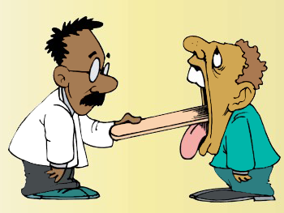
Why adjudicate?
Pharmacovigilance
Collection, detection, assessment, monitoring, and prevention of adverse effects with pharmacological products
Drug safety
TARDIS - ? recurrent strokes
TICH-2 - ? risk of VTE

Slide 6
What needs adjudicating?
SAE – was it related to the drug?
Outcome – is it confirmed?
Need evidence to be able to judge
Nature of evidence will effect decision
High quality trials need high quality evidence

Slide 7
Adverse event: Definition
Any untoward medical occurrence in a study subject administered an intervention and which does not necessarily have a causal relationship with this treatment
A medical or surgical procedure is not an AE, the reason for the procedure is!
Abnormal laboratory values are AEs if ‘clinically significant’, lead to treatment change, are a SAE, or are a safety risk

Slide 8
What to report?
Do not collect all AE:
Trials of known interventions that are already licensed and in routine clinical use
GTN
Aspirin, clopidogrel & dipyridamole
Tranexamic acid
Considerable information is already known for each
Some specific AEs are collected: eg TARDIS minor bleeds
Some trials not all SAEs reported: TICH-2 (though ALL safety outcomes are) – check protocol

Slide 9
Adverse Event or Serious AE?
Common examples
Headache
UTI
Nausea
Vomiting
Persistent weakness
Not eating and drinking
Poor progress with rehabilitation

Slide 10
SAE: Components - Question
Any untoward medical occurrence that?
Results in death
Is life-threatening
Requires inpatient hospitalisation or prolongation of existing hospitalisation
Is an adverse event assessed as severe
Results in persistent or significant disability/incapacity
Is a congenital anomaly/birth defect
Is medically important
Notes:
10

Slide 11
SAE: Components - Question
Any untoward medical occurrence that?
Results in death
Is life-threatening
Requires inpatient hospitalisation or prolongation of existing hospitalisation
Is an adverse event assessed as severe
Results in persistent or significant disability/incapacity
Is a congenital anomaly/birth defect
Is medically important
Notes:
11

Slide 12
SAE: Serious or Severe
‘Severe’
A medical judgement used to describe intensity (severity) of a specific event (as in mild, moderate, or severe myocardial infarction)
The event itself, however, may be of relatively minor medical significance (e.g. ‘severe headache’). So severity does not mean serious
‘Serious’
Based on event outcome or action criteria usually associated with events that pose a threat to a patient's life or functioning
Notes:
12
What’s also worth mentioning at this stage to ensure that there is no confusion or misunderstanding of the difference between the terms "serious” and "severe” is this definition proposed by the ICH HARMONISED TRIPARTITE GUIDELINE CLINICAL SAFETY DATA MANAGEMENT: DEFINITIONS AND STANDARDS FOR EXPEDITED REPORTING

Slide 13
SAE: Medically important
Serious adverse events that may jeopardise the patient or may require medical or surgical intervention to prevent one of the other serious outcomes
Examples:
Allergic bronchospasm requiring intensive treatment in A&E
Convulsion not resulting in in-patient hospitalisation
An abnormal lab value which needs active out-patient management

Slide 14
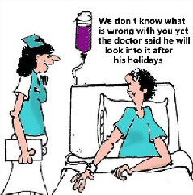
When to report?

Slide 15
SUSAR
Suspected Unexpected Serious Adverse Reaction:
Unexpected
Unlikely in context of antiplatelet agents
Serious – needs to meet criteria for serious
Fatal
Life threatening
Disabling
Hospitalisation (admission or prolongation)
Teratogenic
Medically important
Reaction
Suspected drug reaction
Not just a consequence or complication of stroke

Slide 16
Relationship / causality
Relationship Other cause?
Definitely v. strong none
Probably strong unlikely
Possibly suggestive equally likely
Unlikely weak likely
Not related none v. likely

Slide 17
Diagnostic evidence
Give as much information as possible:
Pathology PM, …
Radiology CT, MR, Carotid, …
ECG AF, MI, LVH, …
Bacteriology …
Biochemistry LFTs, CRP, …
Haematology FBC, ESR, …
Clinical NIHSS, …
Comment …
Too much info is better than too little

Slide 18
Example 1

Slide 20
Example 2

Slide 22
Same patient
Death is an outcome, not an event

Slide 23
Example 3

Slide 25
Example 4

Slide 26
Example 5

Slide 27
Example 6

Slide 28
?

Slide 29
Example 7

Slide 30
Data from this SAE
Data from another SAE (PE) on the same patient

Slide 31
1 or 2 SAEs?

Slide 32
SAE: Problems in trials
Failure to report
Too little diagnostic evidence submitted (or available)
Chase other hospitals, fax available information
Failure to report promptly
If uncertain, ask Coordinating Centre

Slide 33
Summary:
Explained AE/SAE processes
If in doubt: ASK
Check the protocol
Check with the PI or other clinician
Better data improves reporting process
Reduced number of data queries
Saves time for investigators and trial staff

Slide 34
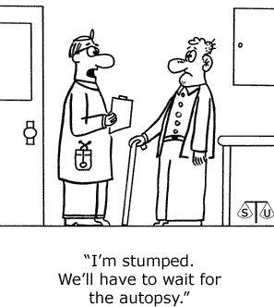
Questions?

